Slide 1
Mason Academy PTA / School Advisory Council Meeting
April 6, 2021
4pm – 5pm

Slide 2
MSTEP Assessments for 3rd – 8th Grade Students
Parents:
Students should have a good night’s rest prior to assessment day.
Provide a healthy breakfast the morning of the assessment.
Give words of encouragement to their child before heading off to school.

Slide 3
MSTEP Assessment 3-8 Continue
What Parents Should Know:
Reporting Assessment Results A Parent Report of your child’s assessment results is available from his or her school each fall. Statewide assessment results are reported at MI School Data through the state’s new Parent Dashboard for School Transparency. In addition to test scores, the Dashboard (www.mischooldata.org/parentdashboard) is filled with important school-level information that parents and others say they want to know about Michigan public schools, including charter schools. Families and others can use the Dashboard to get a more complete picture of how their child’s school is serving students. They also can use the Dashboard to compare a school’s performance with the average performance of other similar Michigan schools. Your ideas can make the Parent Dashboard even better! Send feedback to MDE-ParentDashboard@michigan.gov.

Slide 4
How to Help Your Child on District Assessments
Where to Find Assessment Resources To provide parents with information on student testing, state assessments, and how you can help your child prepare, the Michigan Department of Education (MDE) has developed several print and video communication tools (see back page for descriptions). You can find parent resources on the following pages: M-STEP web page (www.michigan.gov/mstep) PSAT web page (www.michigan.gov/psat) MME web page (www.michigan.gov/mme) MI-Access web page (www.michigan.gov/MI-Access) Early Literacy and Mathematics Benchmark web page (www.michigan.gov/earlylitandmath) WIDA web page (www.michigan.gov/wida)

Slide 5
Parent/Student What to Expect When Testing
Click on the link to view video.
https://youtu.be/U2rfXgLuhLs

Slide 6
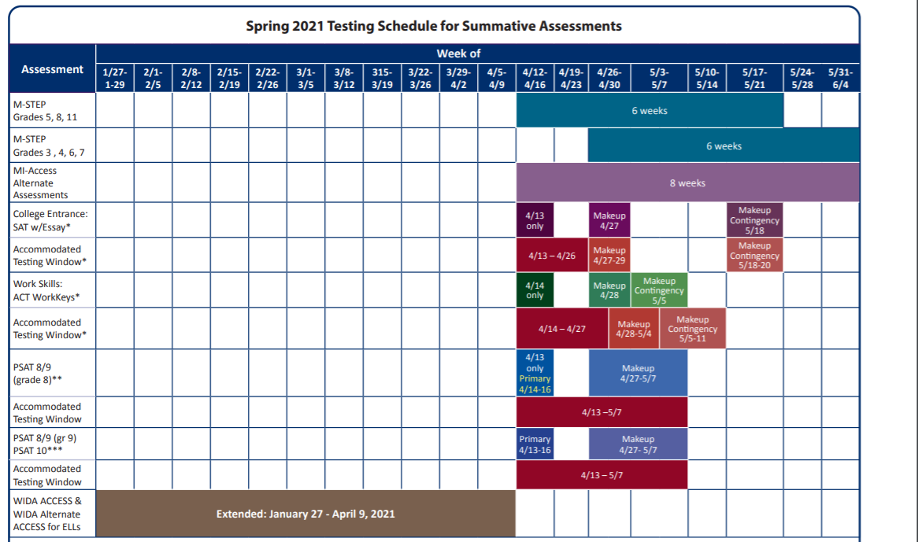
Statewide Assessment Schedule

Slide 7

Quarter 4 Schedule Survey
https://bit.ly/Q4ReturnSurvey
Click on the link above to complete the Q4 Schedule Preference Survey.
This information will be used help Mason measure how many families prefer their children to return to learn in-person, online, or through some combination of both.
Parents will need their children’s DPSCD Username & Password to complete the survey.
Survey closes April 14, 2021

Slide 8
Semester 2 Grading Procedures
PK-2: Teachers are required to limit graded assignments up to one per core subject per week. Teachers must also provide an assignment list to students and families each Monday for submission the following Monday. The assignment list should also communicate any assessments, which would be in addition to the graded assignments, scheduled for that week, and must be posted in Teams as a Tab in the General Channel.
3-5: Teachers are required to limit graded assignments up to two per core subject per week. Teachers must also provide an assignment list to students and families each Monday for submission the following Monday. The assignment list should also communicate any assessments, which would be in addition to the graded assignments, scheduled for that week, and must be posted in Teams as a Tab in the General Channel.

Slide 9
Semester 2 Grading Procedures
6-8: Teachers are required to limit graded assignments to up to two per subject (including electives) per week. Students should be provided with a syllabus, which includes expected assignments, test, and quizzes. At a minimum, syllabi must be posted with assignments for the upcoming week, but teachers may extend the period of the syllabus (e.g., for the quarter or semester). Assessments may be in addition to the limited graded assignments. The syllabus must be posted in Teams as a Tab in the General Channel so that it is accessible for students and families.

Slide 10
Late, Resubmitted or Missing Work
Time to Catch Up and Get Help: If their school has not already introduced Office Hours into the schedule, teachers should set aside at least one, regularly scheduled period each week dedicated to assisting students with:
Completing graded assignments for the week
Making up missing assignments
Resubmitting assignments for improved grades
Retaking assessments
Support should take place during an existing class period/regular time scheduled for the class to meet during the school day, and not during an additional after school meeting, for example.

Slide 11
Late, Resubmitted or Missing Work
Students may submit late graded assignments within a 10 school day window of their designated due date. Students may resubmit graded assignments for improved grades within a 10 school-day window of receiving feedback on the graded work. Assignments that are assigned or returned with a grade within the last 10 school-days of the quarter must be submitted/resubmitted two days prior to the end of the quarter. Teachers should also practice discretion and can consider extenuating circumstances to grant students additional time for submitting or resubmitting assignments, through coordination with the student and family.

Slide 12
Late, Resubmitted or Missing Work
Zeros with Opportunities to Recover: Teachers are still able to assign zeros for missing work but should acknowledge effort and encourage the use of late and resubmitted work options to support students initially earning a zero.

Slide 13
Assignment Retakes
Assessment Retakes with Limits: Students may retake a test or quiz up to two times on teacher-identified re-take days during class office hours/the support period. Teachers can design a new assessment that addresses the same standards and content as the original assessment, with updated questions, or they may allow students to retake the same assessment, at their discretion. The highest grade will be counted. Families should receive specific guidance that they are not to provide help on student assessments because they are an important opportunity to assess mastery. Families should also receive a calendar of assessment re-take days at the beginning of each week, with their assignment list/syllabus.
Teachers should regularly communicate with students and their families about missing assignments and graded assignments and assessments so that students and families can submit late work or resubmit work or retake an assessment for an improved grade.

Slide 14
Grading
Introduce G and NC Grades in 3-12: Schools will use a modified version of the traditional grading scale. Teachers will record letter grades, but a student who earns a D grade for the final semester grade will receive a G (credit). A student who earns an F grade will receive an NC (no credit). Students who receive a G will earn credit for the course and their grade point average will not be affected. Students who receive an NC will not earn credit for the course and their grade point average will not be affected. Students earning an NC would be required to retake the course for future credit.
The key advantage to this is approach is that a student facing hardship this year will not face undue deficits in their GPA when applying to colleges, work, etc. Therefore, we will look to retroactively apply G and NC grades to Semester 1.

Slide 15
Grading & Homework
Expand the point range for D(G): Students who earn a 50% or higher will earn a G (50-69% range, rather than 6069% range). This would be for Semester 2.
Attendance Minimum for a D(G): Students who are attending and participating in class activities and assignments at least 80 percent of the time (four out of five days of the week) cannot receive lower than a D. Students who attend fewer than 4 classes per week but are turning in graded assignments and taking assessments should earn grades based on their performance on those assignments and assessments. This would be for Semester 2.
Homework should be limited to assigned reading, studying, and completion of maximum number of weekly graded assignments that may not have been finished during class time. In the weekly assignment list or syllabus, teachers may offer ideas for reinforcement or extension activities for students to complete with their families or on their own. However, these activities are not required to be turned in and they will not be graded.

Slide 16
Grading Presentation
For more information on DPSCD’s new grading procedures, please click on the following link to view the video.
https://youtu.be/ZOzwbm9hFkA

Slide 17


PTA City Year Updates
4/6/2020

Slide 18
Student Council Updates
Conversations on what makes an impactful leader
Exploring opportunities for leadership roles in life in all different levels
Last week we took our Leadership Compass quiz to see what type of leader we are and what are our strengths
This coming week we will be looking into leadership opportunities that excite us using our information we got from the previous week from our leadership compass

Slide 19

Recap: March Events
Let's take a look at some fun events that happened in March!

Slide 20

March Reading Challenge
44 student participants
7,044 total minutes read
193 activities completed
Student Winners (next page)
Notes:
https://forms.office.com/Pages/ResponsePage.aspx?id=n4nHpSnR9kisiI-X82badFd1SKE9YixIluQJAoq49qRUODZFR045NDJFTDZZMThURDQyOE1FSFFFRCQlQCN0PWcu

Slide 21



March Reading Challenge Winners & Prizes
  Aubree Lyte
  Renaye Murphy
  Jaeda Loury
  Pierce Hatten-Fox
  Keandre Stokes
  Jessica Horton
  Adbul-Qadir
  Terrone Vance
  Kiven Stokes
  Tayshawn Moore
  Trina Hubbard
  Jayshawn Calloway-Davis
  Heaven Martin
Prizes Include: Little Caesars Gift Card, Lions Gear, Bookmark, Candy, and Certificate!
Ms. Buja will call parents to arrange an appointment for prize pick-up

Slide 22

Pi Palooza
3/8-3/12
Students were challenged to answer daily math questions to celebrate Pi Day!
Students answered 263 math questions in one week!
Teachers and the City Year team created a video to reward students! Check it out (link in chat)
Notes:
https://youtu.be/JuIwBaO383w

Slide 23

6th-8th Grade Attendance Challenge
Ms. Gulley and the City Year team will be holding an attendance challenge for the 6th-8th grade.
Students who achieve 70% attendance or higher will be able to go on a virtual field trip to Tokyo, the Amazon Rainforest, or an African Safari Park.
The challenge is taking place during the first three weeks of April.

Slide 24


Slide 25
What’s Happening at Mason? Events for April 2021
April 6: Monthly PTA/School Advisory Council Meeting. 4pm
April 12: PSAT & MSTEP Begin with 5th & 8th grades. Students taking MSTEP must be scheduled to report to the building.
April 13: Principal’s Office Hours 3:30pm – 5pm
April 20: End of Quarter 3
April 27: Quarter 3 1st – 8th Grade Report Card Day
April 28: Mason Academy Virtual Open House

Slide 26
Access to Vaccine for DPSCD Families & Students Older than 16
DPSCD Families,
Please be advised that any DPSCD family living in Detroit or student living in the city who is older than 16 can receive a free COVID vaccine shot at the district schools listed below. The district is partnering with the City of Detroit to provide free COVID vaccine access at 7 school locations during the week of April 12-16. The locations will be offering the one shot Johnson & Johnson vaccine between the hours of 8 a.m.-5 p.m. The vaccine is two shots for those younger than 18 through Pfizer. Appointments for all locations can be made at 313-230-0505. Walkups are also welcome as well.
Monday, 4/12 Henry Ford HS & Western
Tuesday 4/13 Randolph CTE School
Wednesday 4/14 Brenda Scott Academy & Cass Tech
Thursday 4/15 Breithaupt Career Center
Friday 4/16 East English Village Prep

Slide 27

What questions do you have?

Slide 28
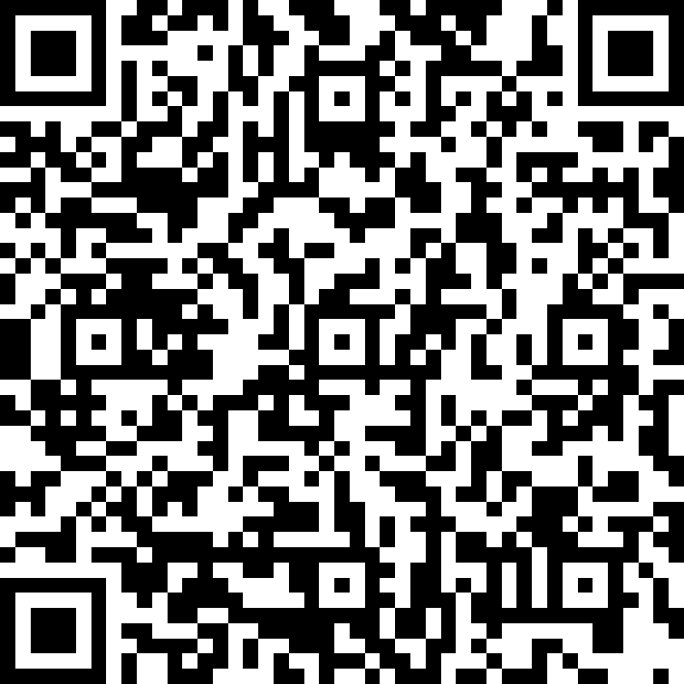
Thank you for attending! Please complete the survey
Please scan the barcode to the left of click on the link below to complete our survey for our April 6, 2021 PTA meeting.
https://forms.office.com/Pages/ResponsePage.aspx?id=3NCiLp2IvEKbTDAnH4LjNSIZ0Bhxnq1ErvYzMNthL39UNkhaMjdKMlZJT0xUT0FXNTdYTjNCMjlPTy4u

